Slide 1


FYP - 1
AI Driven Stock Market Prediction With Sentiment Analysis
Muhammad Wasif Sajjad (2672-2022)
Syed Muzammil Ahmed (3014-2022)
Ghufran-E-Azam (2536-2022)
Supervisor: Dr Taha Shabbir
Department of Computing, FEST
Hamdard University

Slide 2
Summary
Problem Statement
Objective
FYP Scope
Our methodology
Our Project Plan (Time lines)
FYP Deliverables
Budget / Costing (if any)
Literature Review
30% of Work (Demo)
References

Slide 3
Problem Statement
PSX forecasting models largely ignore investor sentiment, relying mainly on historical price data and technical indicators. Despite advances in machine learning, this limits the focus and reduces the ability of models to capture real-time market behavior and psychological factors influencing stock movements. The absence of sentiment integration restricts prediction accuracy, highlighting the need for hybrid forecasting models that combine quantitative data with investor sentiment (Raza & Akhtar, 2024).

Slide 4
Objective
Develop a hybrid prediction model that combines financial time-series data with sentiment analysis to forecast HBL stock prices on the Pakistan Stock Exchange (PSX).
Use FinBERT and the Loughran–McDonald financial sentiment dictionary to extract accurate, finance-specific sentiment from local news sources.
Apply Bi-LSTM neural networks to effectively capture sequential patterns and trends in stock price movements.
Evaluate the model’s performance using RMSE, MAPE, and directional accuracy, targeting a prediction accuracy of 85–90%.
Design a scalable and ethically responsible framework that supports future academic research and real-world financial analysis.

Slide 5
FYP Scope
Forecast daily HBL stock prices on the Pakistan Stock Exchange (PSX) from January 2020 to July 2025.
Utilize OHLCV financial data from yfinance along with sentiment data extracted from local news sources such as Dawn and Business Recorder.
Target a prediction accuracy of 85–90%, evaluated using RMSE, MAPE, and directional accuracy.
Focus exclusively on HBL to maintain manageable complexity, while designing the framework to scale to other PSX stocks and real-time data.
Ensure ethical, transparent, and responsible sentiment analysis when using financial news data.

Slide 6
Our Methodology
Development Framework
Adopt an Agile development approach to support iterative development, flexibility, and continuous model improvement (Highsmith, 2009).
Data Collection
Stock Market Data:
Collect historical OHLCV data for HBL using the yfinance API.
News Sentiment Data:
Gather financial news through RSS feeds and web scraping from trusted local sources such as Dawn and Business Recorder.

Slide 7
Our Methodology
Sentiment Analysis
Apply FinBERT, a finance-specific transformer model, to classify sentiment in financial news articles (Araci, 2019).
Enhance sentiment accuracy by complementing model outputs with the Loughran–McDonald financial sentiment dictionary (Loughran & McDonald, 2011).
Modeling Approach
Use LSTM neural networks with an attention mechanism to capture temporal dependencies and highlight key patterns influencing stock price movements (Hochreiter & Schmidhuber, 1997; Fischer & Krauss, 2018).

Slide 8
Our Methodology
Evaluation Metrics
Evaluate model performance using:
RMSE (target < 5%)
MAPE (target < 10%)
Directional Accuracy (target 85–90%)

Slide 9
Our Project Plan
•Project Initialization : Defined problem statement, research objectives, and team roles. Finalized data sources and began initial literature review.
•Data Collection : Collected historical OHLCV data for HBL from yfinance and gathered financial news articles from Dawn, Business Recorder, and The News.
•Data Preprocessing : Normalized stock data and cleaned news text using tokenization, lemmatization, and stopword removal.
•Sentiment Annotation : Applied FinBERT and Loughran-McDonald Dictionary to assign sentiment scores (positive/neutral/negative) to news articles.
•Feature Engineering : Merged sentiment scores with stock data by date. Created lag features and structured dataset for model input.
•Model Design : Designed LSTM model with attention mechanism. Finalized hyperparameters and evaluation metrics.

Slide 10
Our Project Plan
•Model Training : Trained and tuned the LSTM model using 5-fold cross-validation. Tracked performance via RMSE, MAPE, and directional accuracy.
•Evaluation : Assessed model on test data. Conducted error analysis and validated prediction accuracy (target: 85–90%).
•Research Validation : Compared results with related studies. Performed statistical validation and finalized findings.
•Report Writing : Drafted full FYP-II research report including all sections, visuals, and references.
•Supervisor Review : Revised report based on supervisor feedback. Finalized formatting and citations.
•Final Submission : Submitted report, prepared slides, and rehearsed presentation for defense.
•FYP-II Evaluation : Presented findings to the evaluation panel, answered questions, and completed project defense.

Slide 11
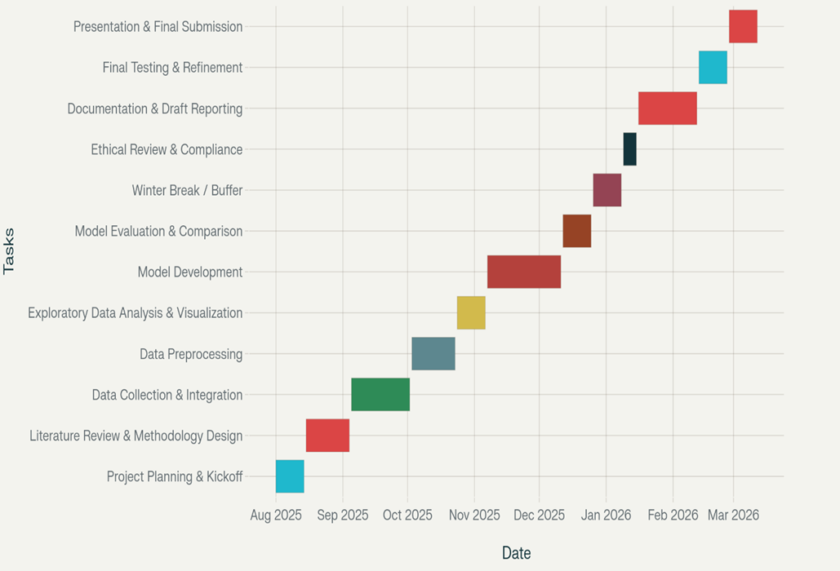
Our Project Plan

Slide 12
FYP Deliverables
Project Deliverables
•Cleaned and validated HBL OHLCV dataset
•Labeled and scored sentiment corpus
•Trained LSTM model with combined feature input
•Research paper with citations and evaluation metrics
•Presentation & poster for FYP-II defense
•Scalable prototype for future PSX stocks

Slide 13
Literature Review
Traditional models (ARIMA, regression, SVM) struggle with nonlinearity and volatility in stock markets (Patel et al., 2015; Chopra & Sharma, 2021).
LSTM-based deep learning models outperform classical approaches by effectively capturing long-term temporal patterns in stock price data (Hochreiter & Schmidhuber, 1997; Singh & Sharma, 2022).
Sentiment-aware models using FinBERT and the Loughran–McDonald dictionary improve prediction accuracy by incorporating investor psychology (Araci, 2019; Loughran & McDonald, 2011).
Hybrid approaches combining price data and sentiment signals are especially effective in emerging markets such as the Pakistan Stock Exchange (PSX) (Malik et al., 2024; Haroon et al., 2023).

Slide 14
Demo of 30% of Work
Project Setup Completed
Problem definition and methodology finalized
Data Pipeline Established
Data collection and integration completed
Data preprocessing (cleaning, normalization, handling missing values)
Final dataset created and split for training/validation
Feature Engineering
Relevant features extracted and transformed
Dataset optimized for sequential modeling
Ready to proceed with model evaluation, tuning, and comparison

Slide 15
Demo of 30% of Work
Model Development (Initial Phase)
Bi-directional LSTM model selected and implemented
Initial model training completed with stable convergence
Current Status
Core data and modeling foundation completed
Ready to proceed with model evaluation, tuning, and comparison

Slide 16
Reference
•Araci, D. (2019). FinBERT: Financial Sentiment Analysis with Pre-trained Language Models. arXiv preprint arXiv:1908.10063.
•Chopra, R., & Sharma, G. D. (2021). Application of Artificial Intelligence in Stock Market Forecasting. Journal of Risk and Financial Management, 14(2), 45.
•Deveikyte, V., et al. (2022). Sentiment Analysis in Financial Markets: A Review. Journal of Financial Data Science.
•Fischer, T., & Krauss, C. (2018). Deep learning with long short-term memory networks for financial market predictions. European Journal of Operational Research, 270(2), 654–669. https://doi.org/10.1016/j.ejor.2017.11.054
•Haroon, O., et al. (2023). Localized sentiment analysis for emerging stock markets. Emerging Markets Journal.
•Highsmith, J. (2009). Agile Project Management: Creating Innovative Products. Addison-Wesley.
•Hochreiter, S., & Schmidhuber, J. (1997). Long short-term memory. Neural Computation, 9(8), 1735–1780.
•Khan, M., Ahmed, S., & Tariq, R. (2023). Challenges in stock price prediction on Pakistan Stock Exchange. Journal of Emerging Financial Markets, 12(2), 45–59.
¨

Slide 17
Reference
•Khan, M., & Shaikh, S. (2024). Investor sentiment and stock market volatility in Pakistan. Pakistan Economic Review.
•Loughran, T., & McDonald, B. (2011). When is a liability not a liability? Textual analysis, dictionaries, and 10-Ks. The Journal of Finance, 66(1), 35–65.
•Mokhtari, S., Yen, K.K., & Liu, J. (2021). Effectiveness of Artificial Intelligence in Stock Market Prediction. arXiv preprint arXiv:2107.01031.
•Raza, S., Qureshi, A., & Malik, F. (2025). Sentiment analysis integration for stock market forecasting: Evidence from PSX. Asian Journal of Financial Technology, 7(1), 22–34.
•Shah, T., & Malik, J. (2024). Hybrid models for forecasting in emerging markets: Case of Habib Bank Limited. International Review of Finance and Economics, 19(3), 121–130.
•Vapnik, V. (1995). The Nature of Statistical Learning Theory. Springer.

